Slide 1
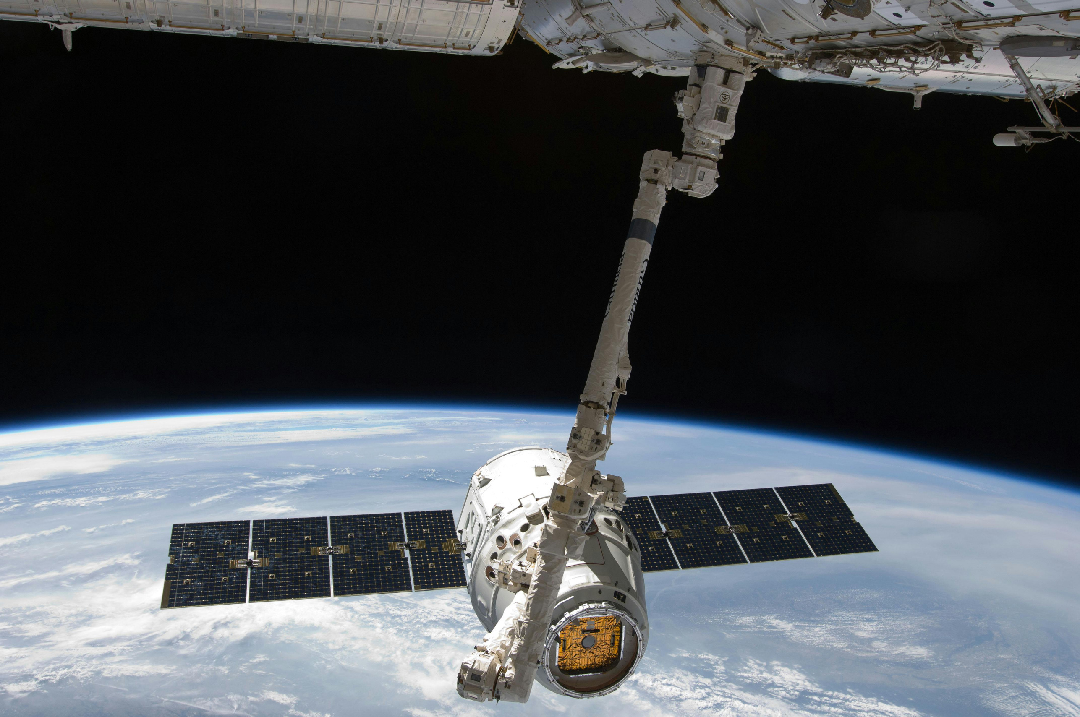
HCF Hackathon
TECH TITANS

Slide 2

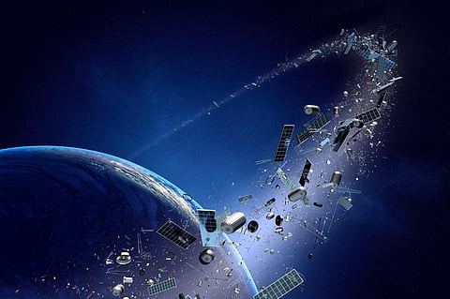
PROBLEM STATEMENT
Space debris, also known as space junk, refers to defunct human-made objects in Earth's orbit that no longer serve a useful function.
Now, the European Space Agency (ESA) estimates there are about 44,700 pieces of space debris. The primary concern is the increasing risk of collisions.

Slide 3
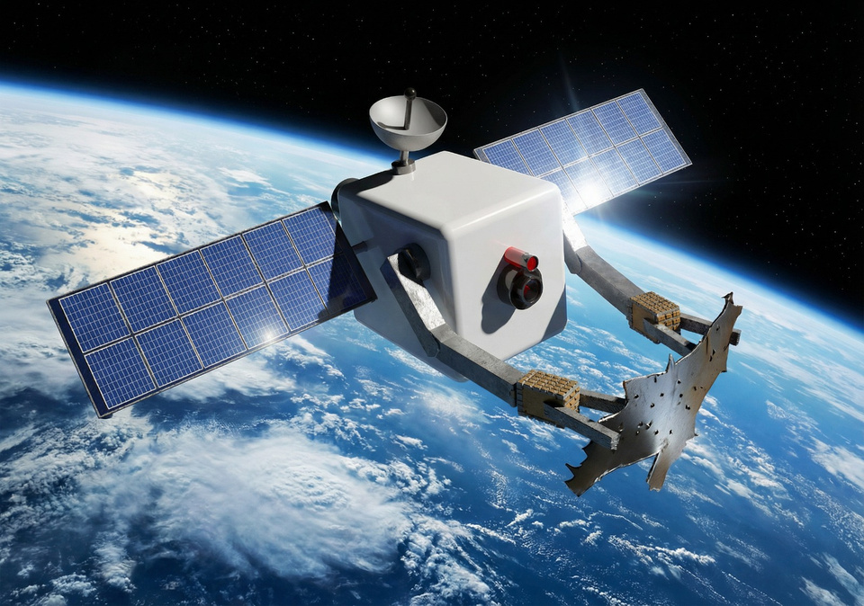

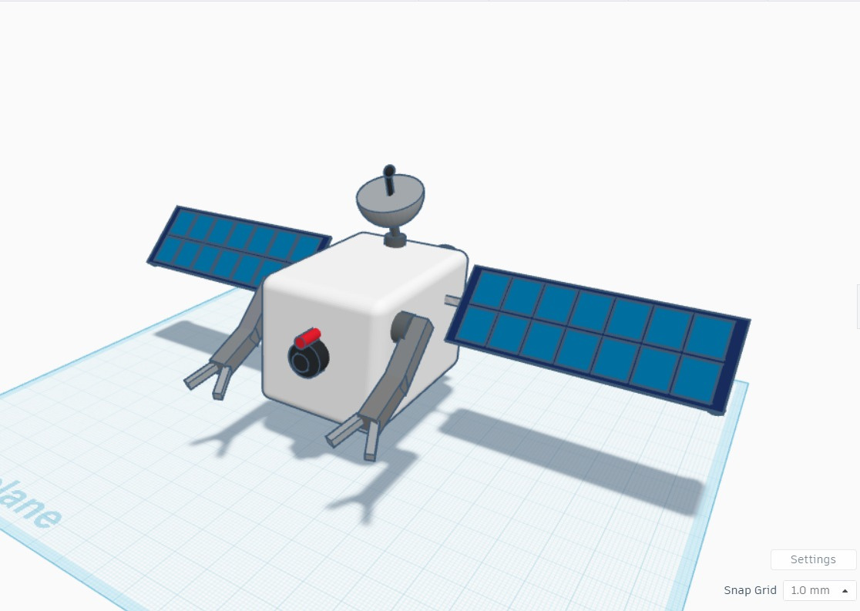
OUR SOLUTION
SU-01
SWACHHTA UPGRAH-01
An autonomous satellite designed to capture space debris and safely deorbit it to reduce orbital pollution and prevent satellite collisions.
Cleaning Earth’s orbit, one fragment at a time.

Slide 4
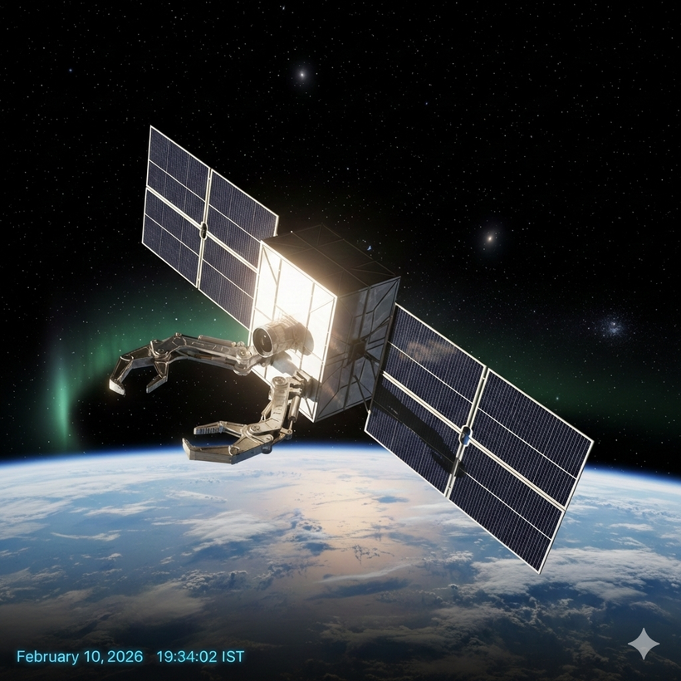
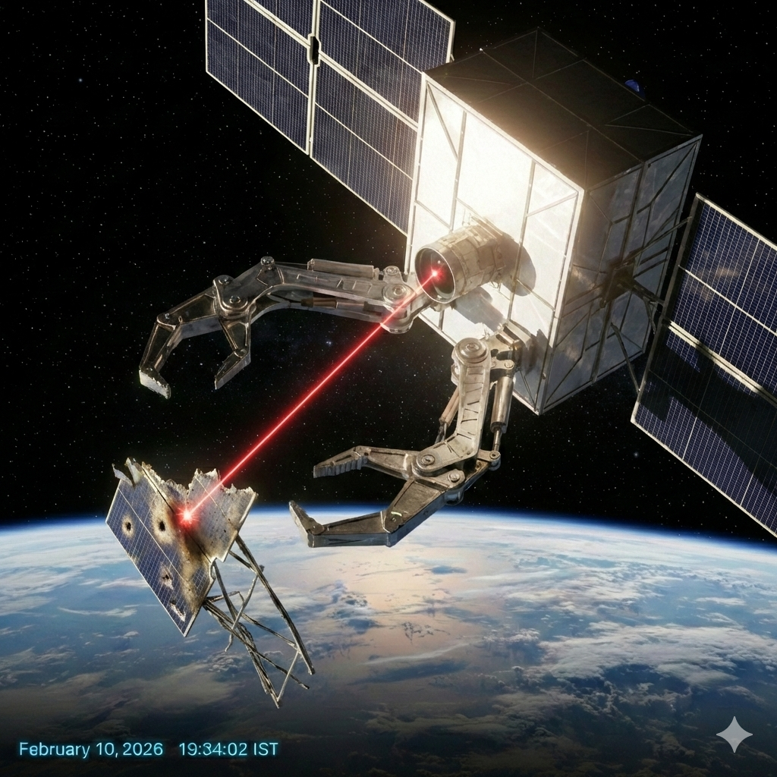
HOW IT WORKS
DETECTION & TRACKING:
IDENTIFY DEBRIS USING RADAR AND OPTICAL SENSORS.
AUTONOMOUS NAVIGATION:
AI-GUIDED LASERS TRACK THE DEBRIS' SPIN TO SYNCHRONIZE A PRECISE, AUTONOMOUS CAPTURE.
MECHANICAL CAPTURE:S:
ROBOTIC ARMS WITH SILICONE OR RUBBER GRIPPERS TO SECURE DEBRIS.
DE-ORBITING:
DIRECT DEBRIS INTO ATMOSPHERE FOR CONTROLLED DISINTEGRATION.

Slide 5
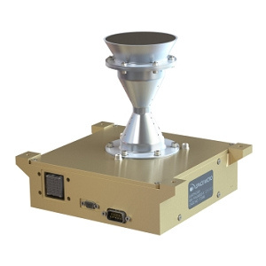
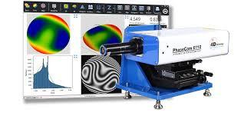
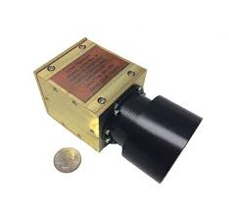
CORE COMPONENTS
VISION CAMERA SYSTEM
Debris detection and tracking
ROBOTIC CAPTURE ARM
Grabbing and handling debris
NAVIGATION & SENSOR SUITE
Positioning and target mapping
LASER RANGEFINDER (LIDAR)
Precise distance measurement

Slide 6

CHALLENGES
DEBRIS CAPTURE RISK – UNSTABLE, FRAGILE, AND COLLISION-PRONE TARGETS
ROBOTIC ARMS IN SPACE – PRECISION ENGINEERING UNDER EXTREME UNCERTAINTY
THERMAL CONTROL SYSTEM (TCS) PROBLEM IS SPACE
DEORBITING LOCATION CHALLENGE – SAFE AND CONTROLLED EARTH DISPOSAL

Slide 7
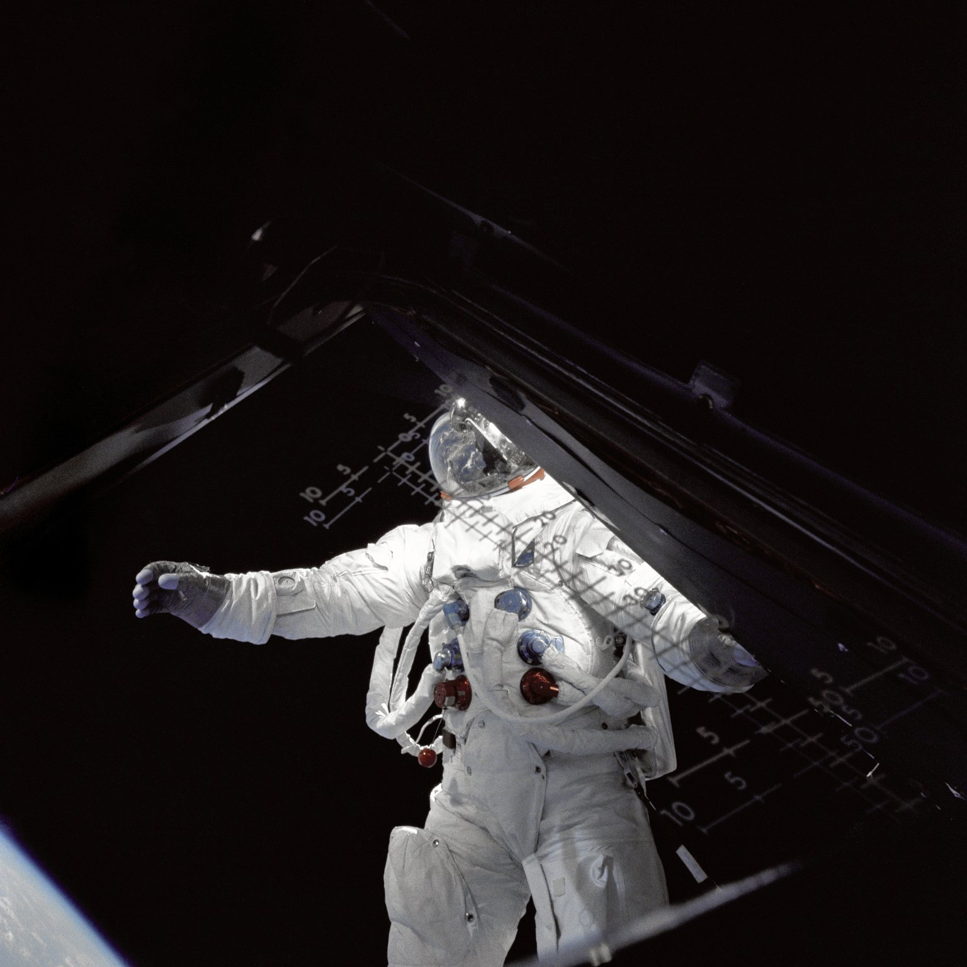
THANK YOU
HARSHIT
VIDHI
VAIBHAVI
VANSH
RUTHUPARNA

